Slide 1


make it
LAST
Everything blue is a guide. Delete it before you download.
Notes:
Slide 1. Hook. Swap in a photo of your product.

Slide 2
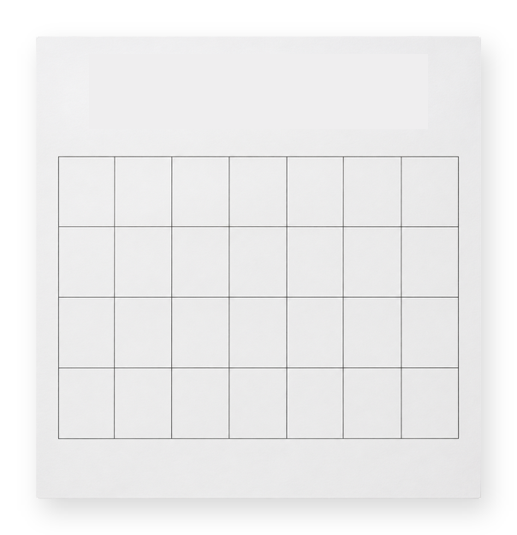
[most wear out
in a year]
month 6
month 1
[make yours last]
Notes:
Slide 2. Second hook: Instagram often shows a carousel starting on slide 2, so this one works as a cover on its own. No photo needed. Edit the page labels and both [bracket] lines.

Slide 3

[rinse after each use]
Notes:
Slide 3. Tip 1: a full-page photo of it. Edit the tip.

Slide 4


[store it upright]
Notes:
Slide 4. Tip 2: swap in its photo. Edit the tip.

Slide 5
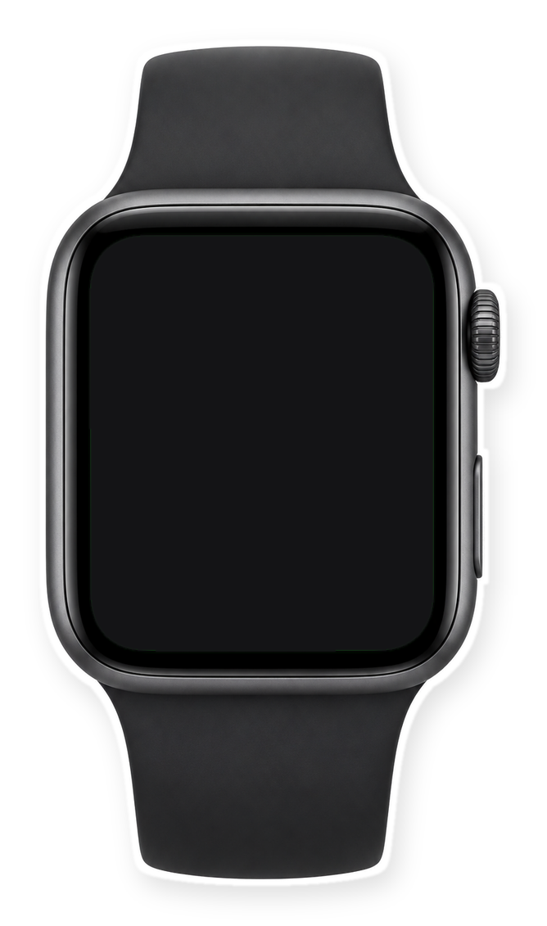

a 2-minute habit
[every Sunday]
Notes:
Slide 5. Swap in a photo of your reminder (or your product) for the watch screen. Edit the day.

Slide 6
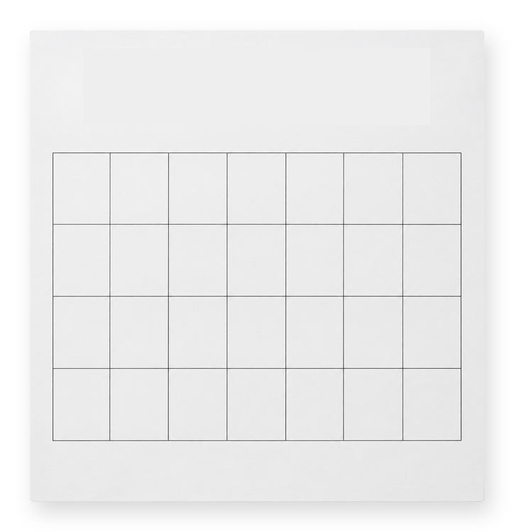
still like new
year 3
Notes:
Slide 6. No photo needed. Edit the page label to your real number.

Slide 7
[still going strong]
Notes:
Slide 7. The result: a full-page photo. Edit the line.

Slide 8


Comment
"[KEYWORD]"
[Product name]
Notes:
Slide 8. Swap in a photo of your product at its best. Type its name and your keyword. Caption to start from (CTA in the first two sentences, 3 hashtags): Comment [KEYWORD] and I will send you [the link]. [One line of real context: who it helps or how you use it.] #[tag] #[tag] #[tag]

